Slide 1
Project I | Deep Learning: Image Classification with CNN
Group Triple pixels

Slide 2
Introduction
Objective: Train a model to classify images using ResNet-18
Tools Used: PyTorch, torchvision, Matplotlib, PIL, Scikit-learn
GPU Acceleration: The code runs on GPU if available

Slide 3
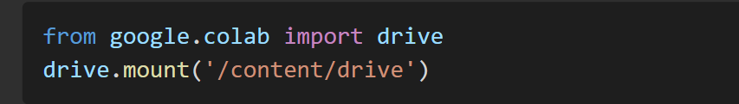
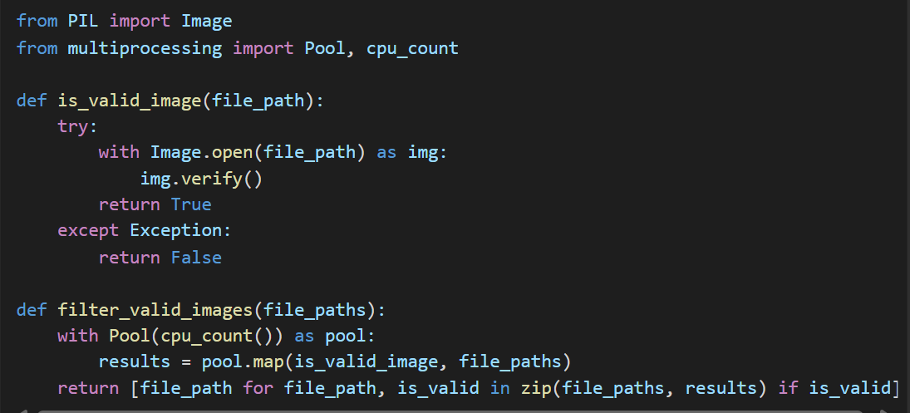
Data Loading and Preprocessing
Code Snippet
Step 1: Mount Google Drive to access dataset files
Step 2: Ensure images are valid before training
Step 3: Use multiprocessing to validate images efficiently

Slide 4
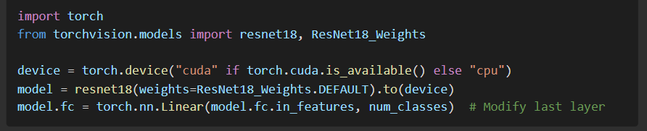
Model Setup
Code Snippet
step 1: Load ResNet-18 with pre-trained weight
Step 2: Move the model to GPU if available
Step 3: Modify the last fully connected layer to match the number of classes

Slide 5
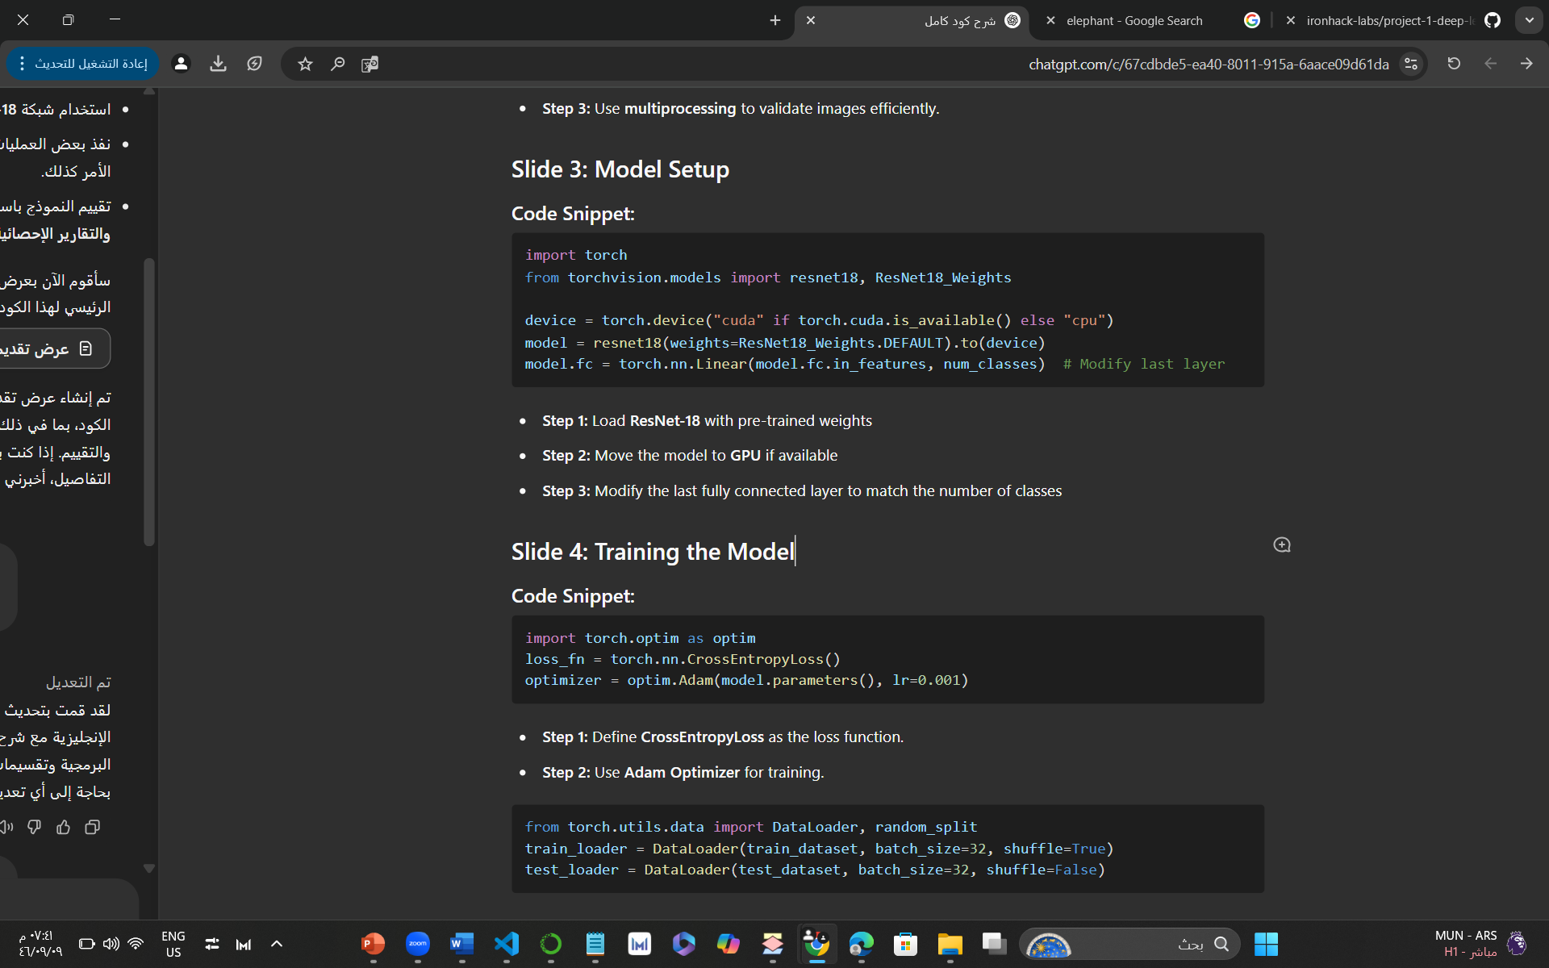
Training the Model
Code Snippet
Step 1: Define CrossEntropyLoss as the loss function
Step 2: Use Adam Optimizer for training
Step 3: Use DataLoader for efficient batch processing

Slide 6
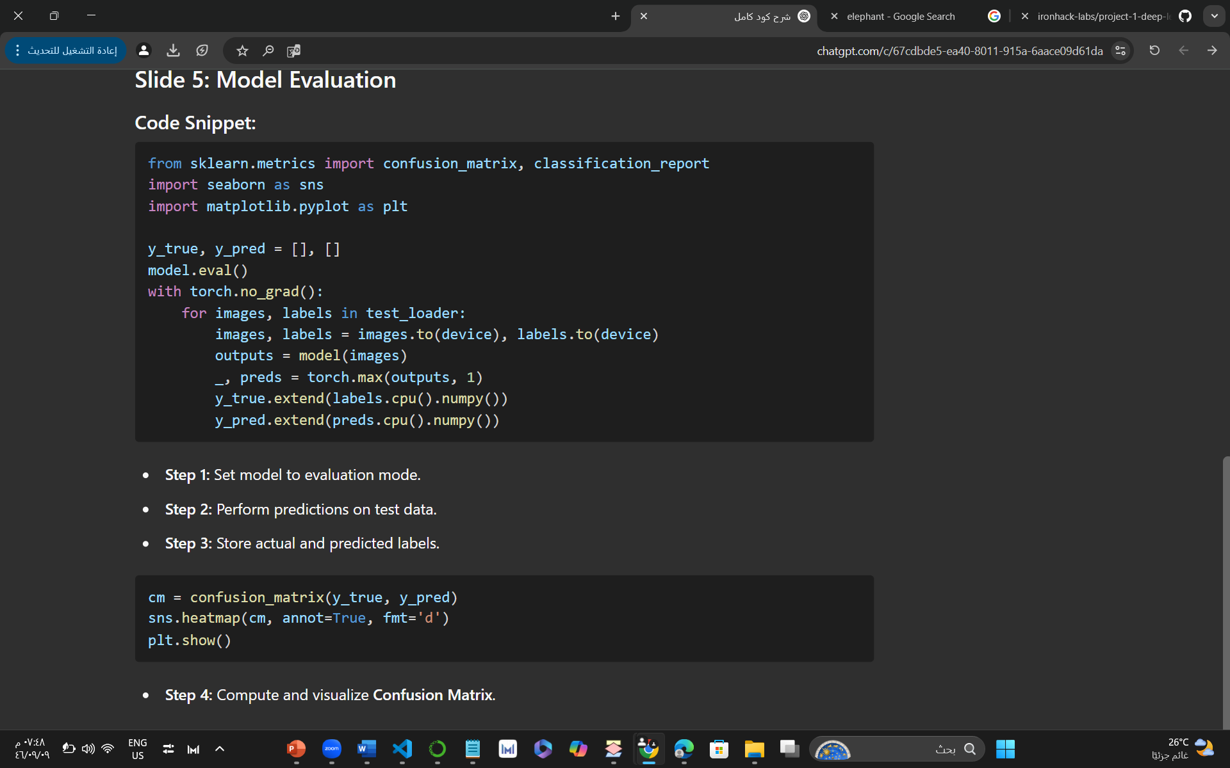
Model Evaluation
Code Snippet
Step 1: Set model to evaluation mode
Step 2: Perform predictions on test data
Step 3: Store actual and predicted labels
Step 4: Compute and visualize Confusion Matrix

Slide 7
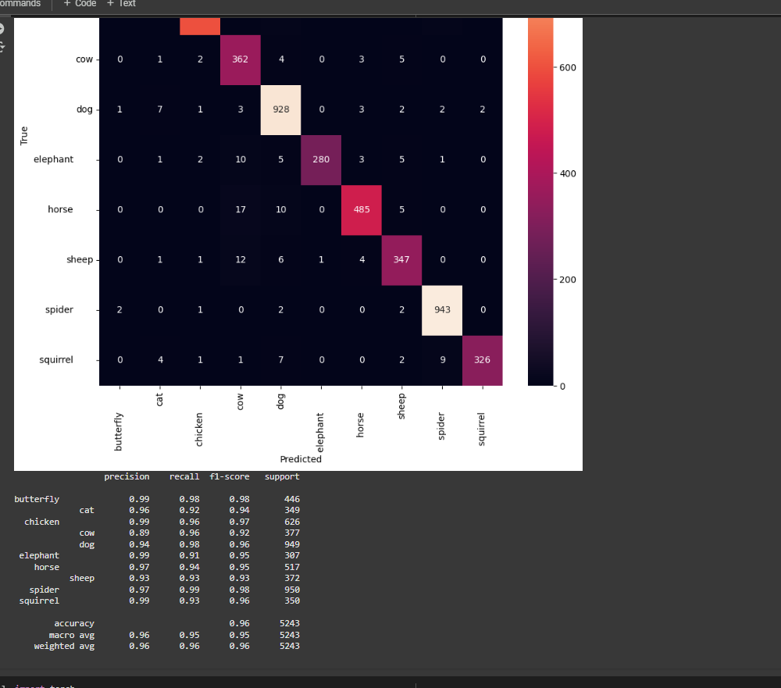
Results and Conclusion
support | f1-score | recall | precision
423 | 0.96 | 0.98 | 0.93 | butterfly
336 | 0.93 | 0.92 | 0.95 | cat
632 | 0.97 | 0.97 | 0.98 | chicken
371 | 0.90 | 0.96 | 0.84 | cow
978 | 0.95 | 0.95 | 0.94 | dog
275 | 0.96 | 0.94 | 0.98 | elephant
520 | 0.96 | 0.95 | 0.97 | horse
369 | 0.90 | 0.85 | 0.96 | sheep
971 | 0.98 | 0.97 | 0.99 | spider
368 | 0.95 | 0.98 | 0.93 | squirrel
5243 | 0.95 |  |  | accuracy
5243 | 0.95 | 0.95 | 0.95 | macro avg
5243 | 0.95 | 0.95 | 0.95 | weighted avg

Slide 8
Interpretation of Results
Classification Report
Accuracy
Precision
Recall
F1-secor
If accuracy is high (>90%)
the model performs well
If accuracy is low (<70%)
improvements may be needed, such as
Increasing dataset size for better generalization

Slide 9
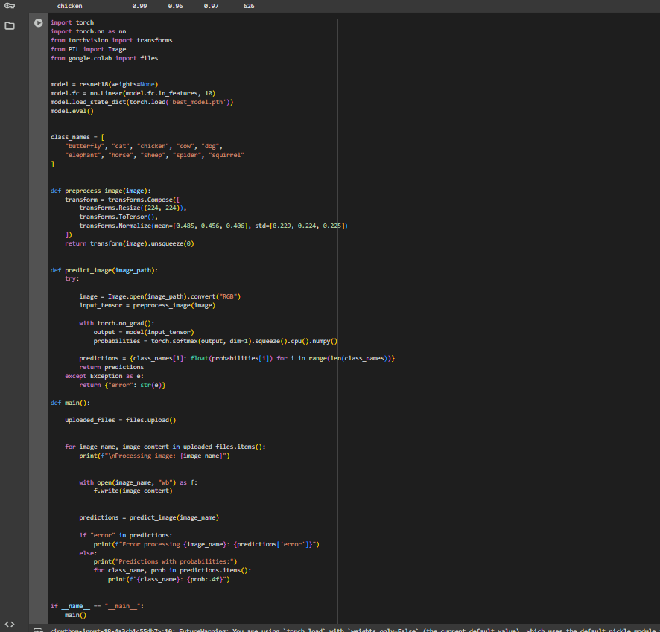
Results and Conclusion
The model can classify images into 10 categories
Uses ResNet-18 modified for multi-class classification
Takes advantage of PyTorch's tools for loading, preprocessing, and predicting images

Slide 10
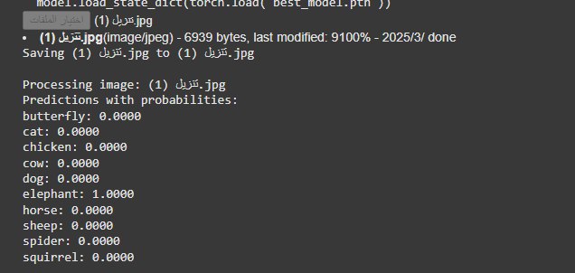
Results and Conclusion
The model predicted the image as an "elephant" with a probability of 1.0000 (100%)
All other classes had probabilities of 0.0000, indicating a very confident prediction

